Slide 1
Adding a GES to Search Google Scholar to PrimoVE
CARLI Office Hours, May 13, 2021
Prepared by Alice Creason, Lewis university

Slide 2
Why add a Google Scholar Search?
Acts as a fallback for links that fail
Provides additional option for open access resources
Final check before creating an ILL article request

Slide 3
Before You Begin
User role(s) required:
General System Administrator
Fulfillment Administrator
ExLibris Documentation:
Adding a General Electronic Service
Google Documentation (Optional):
Search Parameters

Slide 4
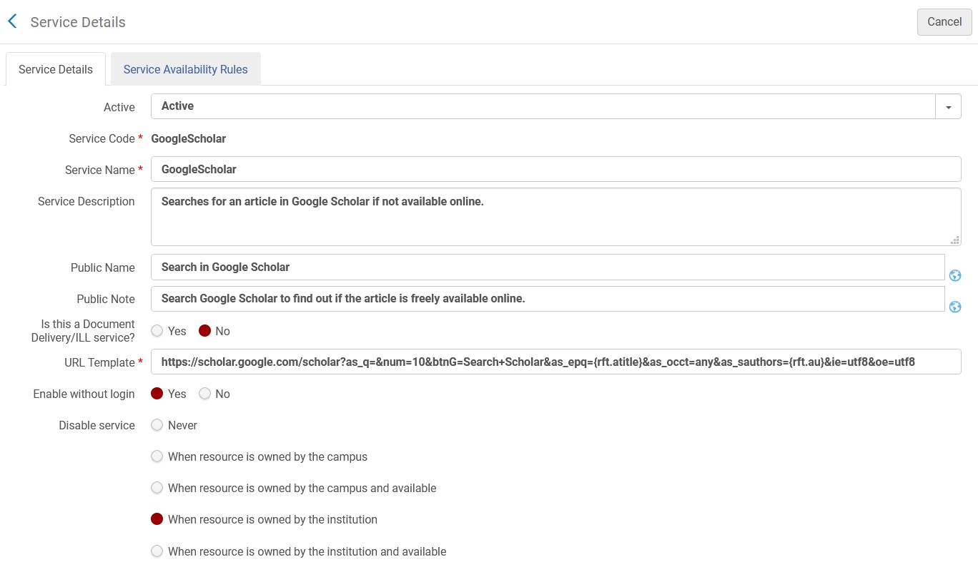
Adding a New GES
In Alma, go to: Configuration Menu > Fulfillment > Discovery Interface Display Logic > General Electronic Services
Click Add Service

Slide 5
URL Template Examples
Simple title search query:
https://scholar.google.com/scholar?as_q=%22{rft.atitle}%22&ie=utf8&oe=utf8
Title phrase search, returns only first 10 results:
https://scholar.google.com/scholar?as_q=&num=10&btnG=Search+Scholar&as_epq={rft.atitle}&as_occt=any&ie=utf8&oe=utf8

Slide 6
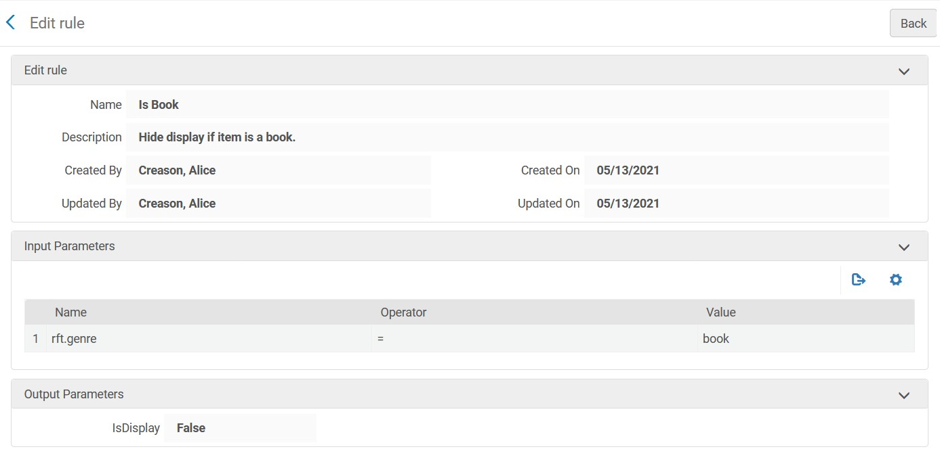
Service Availability Rules
Suggestion:
Hide if the item is a book

Slide 7

Questions?
This Photo by Unknown Author is licensed under CC BY

